Slide 1
MongoDB Features & Operations

Slide 2
Objectives
JSON & BSON Format
Schema Flexibility
Features of MongoDB
Datatypes in MongoDB
CRUD – Read & Create
Indexing functionality

Slide 3
JSON & BSON Format
Javascript Object Notation (JSON) Objects are simple associative containers, wherein a string key is mapped to a value (which can be a number, string, function, or even another object).
This simple language trait allowed JavaScript objects to be represented remarkably simply in text –
{
"_id": 1,
"firstName": "John",
"lastName": "Backus",
}

Slide 4
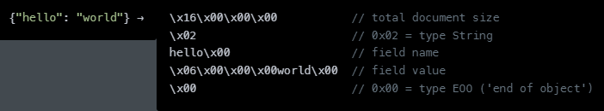
JSON & BSON Format
Binary JSON is a textual object notation widely used to transmit and store data across web-based applications. JSON is easier to understand as it is human-readable, but compared to BSON, it supports fewer data types.
BSON encodes type and length information, too, making it easier for machines to parse. MongoDB stores data in BSON format.

Slide 5
JSON & BSON Format
 | JSON | BSON
Type | JSON files are written in text format. | BSON files are written in binary.
Speed | JSON is fast to read but slower to build. | BSON is slow to read but faster to build and scan.
Space | JSON data is slightly smaller in byte size. | BSON data is slightly larger in byte size.
Encode and Decode | We can send JSON through APIs without encoding and decoding. | BSON files are encoded before storing and decoded before displaying.
Parse | JSON is a human-readable format that doesn't require parsing. | BSON needs to be parsed as they are machine-generated and not human-readable.
Data Types | JSON has a specific set of data types—string, boolean, number for numeric data types, array, object, and null. | Unlike JSON, BSON offers additional data types such as bindata for binary data, decimal128 for numeric.
Usage | Used to send data through the network (mostly through APIs). | Databases use BSON to store data.

Slide 6
Schema Flexibility
Firstly, JSON documents are polymorphic – fields can vary from document to document within a single collection.
Secondly, there is no need to declare the structure of documents to the database – documents are self-describing.
Thirdly, if a new field needs to be added to a document, it can be created without affecting all other documents in the collection, without updating a central system catalog and without taking the database offline.

Slide 7
Features of MongoDB
Ad-hoc queries for optimized, real-time analytics
Indexing appropriately for better query executions
Replication for better data availability and stability
Sharding
Load balancing

Slide 8
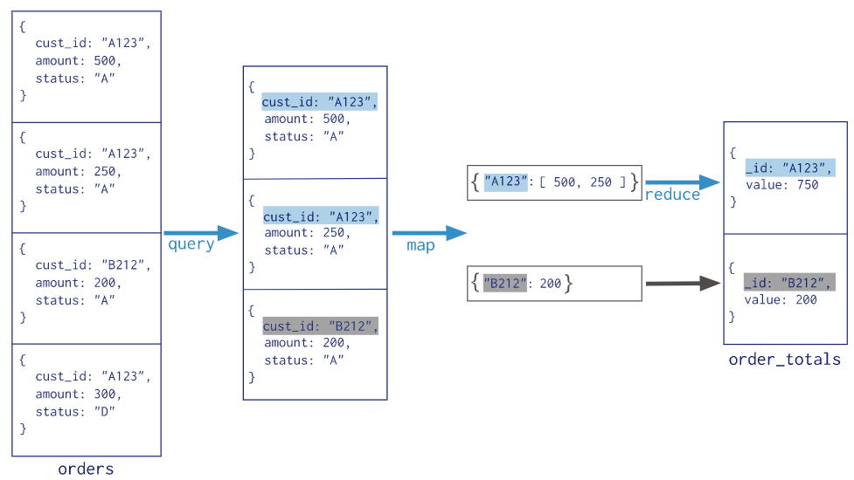
Map-Reduce in MongoDB

Slide 9
Datatypes in MongoDB
String
Integer
Boolean
Double – This type is used to store floating point values
Min/Max Keys
Arrays
Timestamp
Object
Null
Symbol – This datatype is used identically like a string; however, it is generally reserved for a languages that uses a specific symbol type.
Binary
Regular Expression

